Slide 1
NETFLIX-ING YOUR ASSOCIATION
Digital Transformation with a Purpose

Slide 2
INTRODUCTION
REMINDER:
CAE Credits will be available.
“WorkerBee.TV, Inc. – helping organizations use video strategically since 2008, through the Association TV® video platform & services.”
Published – Moving your Association from Analog to Digital
Dan Stevens
President
WorkerBee.TV, Inc.
dan.stevens@workerbee.tv

Slide 3
AGENDA
Lessons from Netflix
Measuring the gap between a Netflix model & your website
Closing the “gap” with digital transformation
Accelerating Digital Transformation – as quick as 90 Days

Slide 4
LESSONS WE CAN LEARN FROM NETFLIX

Slide 5
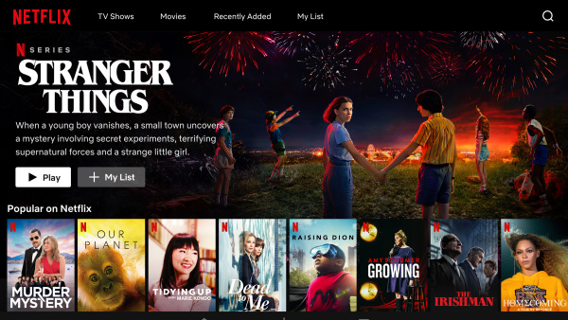
FROM
TO

Slide 6
WHAT BUSINESS IS NETFLIX?
Membership Model
Distribution of Content Created by Experts
Content Creation
Retention is Key
SOUND FAMILIAR?

Slide 7
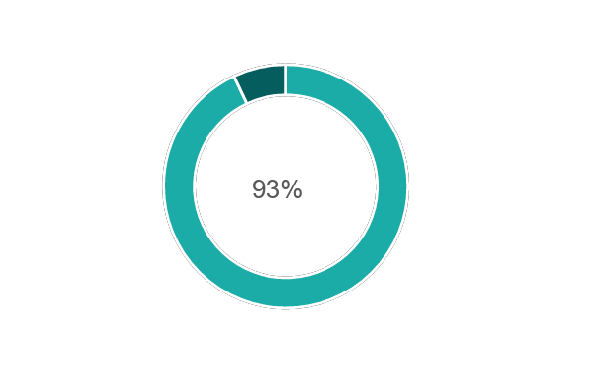
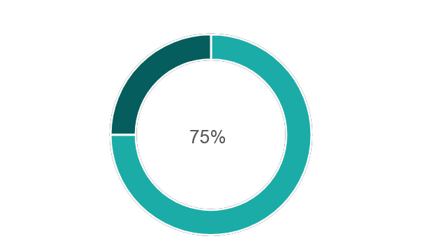
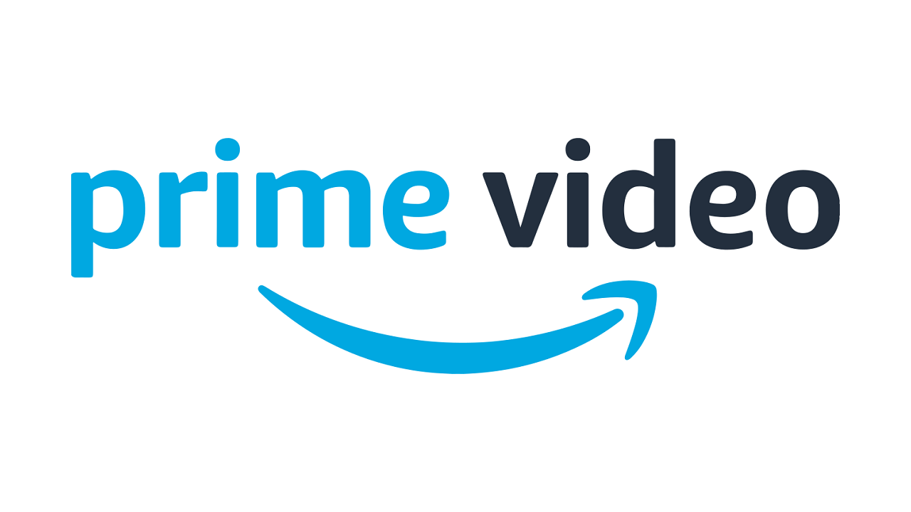
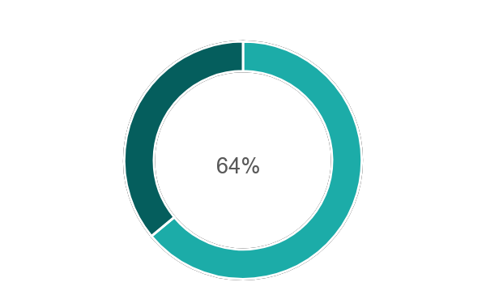
NETFLIX RETENTION RATE

Slide 8
CONTENT IS KEY TO ENGAGEMENT
Renews around 93% of its original content every year.
Cable TV renews only 35% of its content every year.

Slide 9
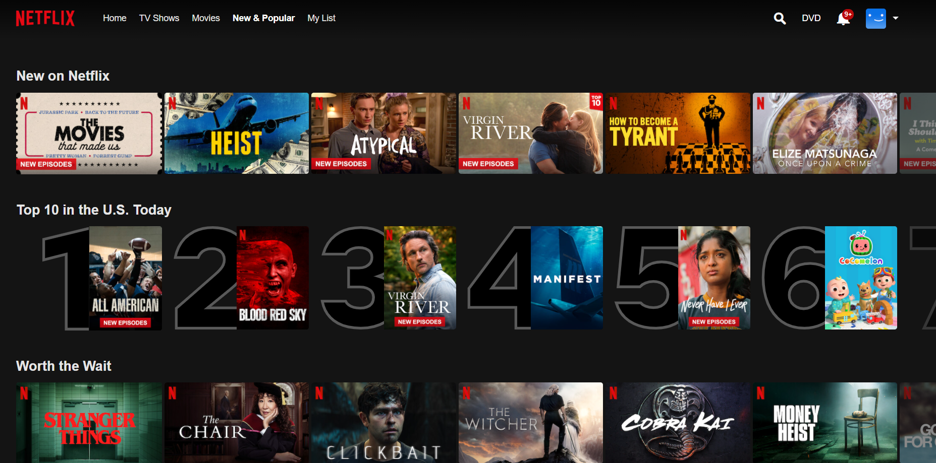
According to Netflix, over 75% of viewer activity is based off personalized recommendations.

Slide 10
NOT ANOTHER ADAM SANDLER MOVIE...

Slide 11
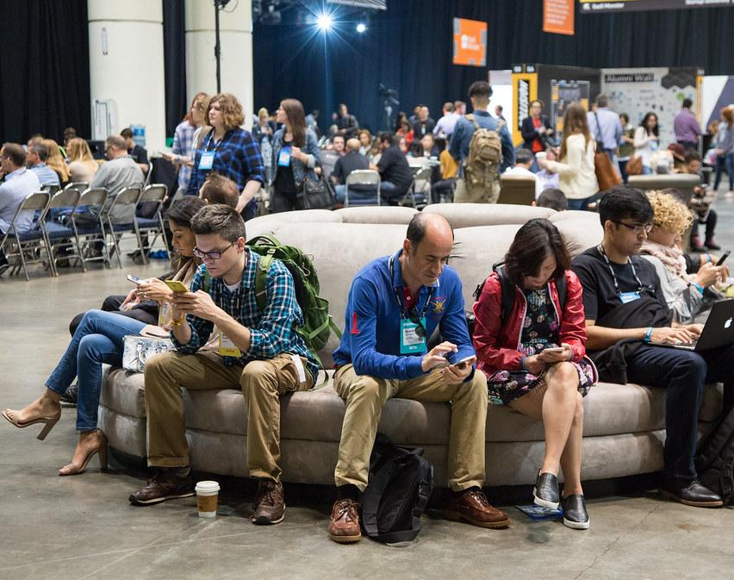
WHAT ARE YOUR MEMBERS THINKING?

Slide 12
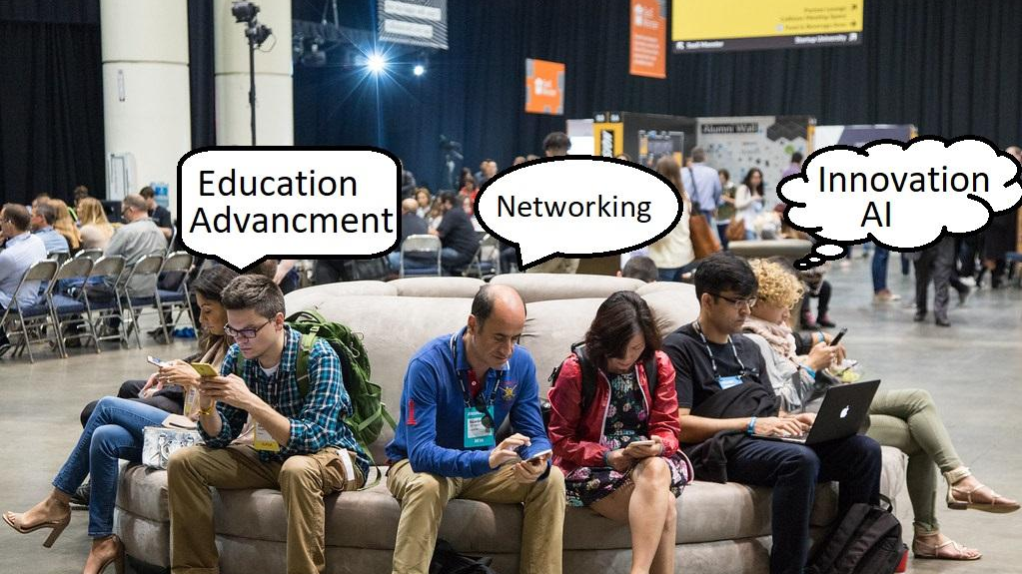

Slide 13
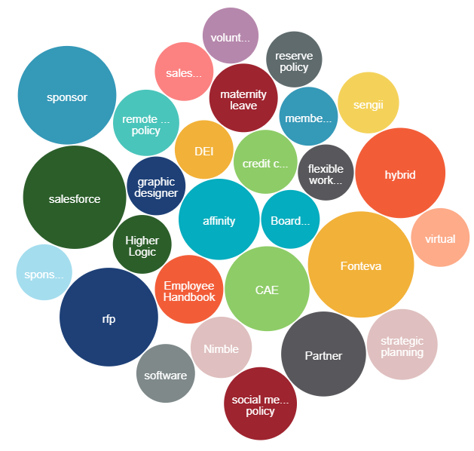
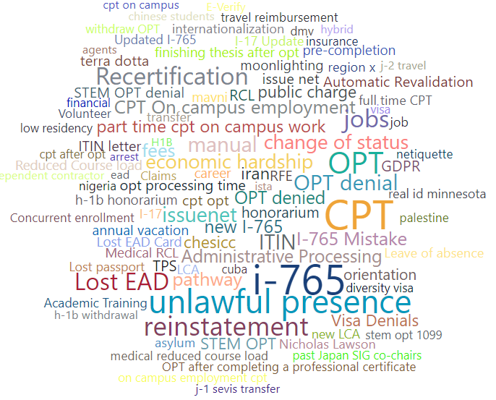
WHAT IS YOUR DATA TELLING YOU?

Slide 14
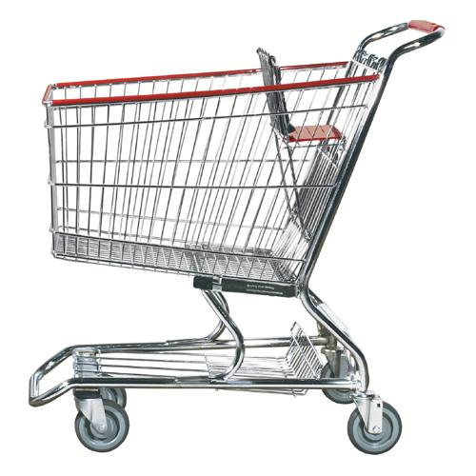
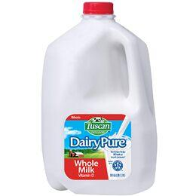
MARKET BASKET
ANALYSIS

Slide 15
MARKET BASKET
ANALYSIS
Notes:
Greg

Slide 16
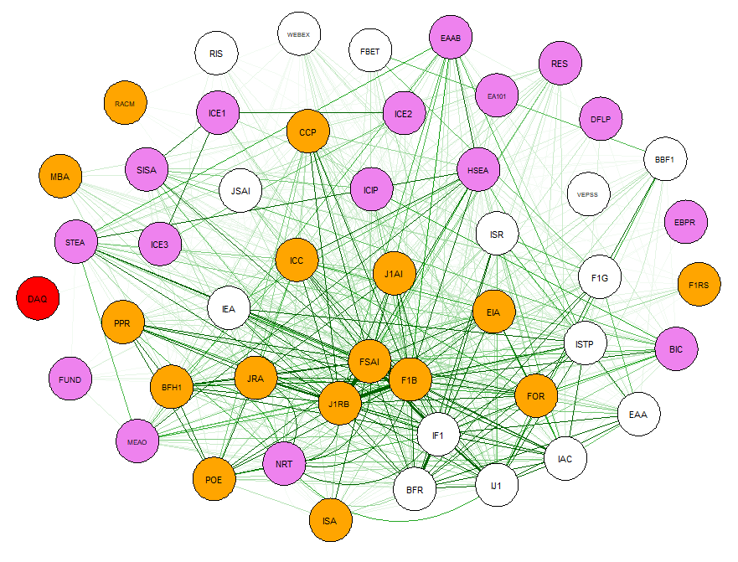
RECOMMENDING THE NEXT STEP

Slide 17
MEASURING THE GAP BETWEEN YOUR WEBSITE & A NETFLIX MODEL

Slide 18
IS THIS YOUR ASSOCIATION?
GROWING DIGITAL ENGAGEMENT IN SILO’S
LMS
EVENTS
COMMUNITY
PLATFORM
WEBSITE
ARTICLES
ASSOCIATION MANAGEMENT SYSTEM
(AMS)
VIDEO
(YouTube)
PODCASTS
(separate platform)
SOCIAL
MEDIA
VIRTUAL
EVENTS
(rented platform)
WEBINARS
Notes:
Dan
The average association is capturing only a fraction of the interactions between them and their members.
Imagine if I told you to really get to know a member but you could only meet with them 4 times per year
How much could you learn if you were interreacting with them weekly or daily? Know how to serve their needs.
As more and more of your engagement becomes “digital”, it is important to not only control the experience, monetize that experience but also capture that experience so you can learn how to continually improve your programming and service for members.

Slide 19
THE FUTURE STATE IS FULLY INTEGRATED
LMS
VIRTUAL
& HYBRID EVENTS
VIDEO
PODCAST
ARTICLES
WEBSITE
COMMUNITY
PLATFORM
Discovery
Current State Analysis
Collaborative Future State Vision
Gap Analysis
Data & Analytics Roadmap
ASSOCIATION MANAGEMENT SYSTEM
(AMS)
MARKETING AUTOMATION
CRM
(Salesforce, Marketo, Hubspot and more)
Notes:
Dan
The Association TV Model organizes all of your digital content into one platform with multiple modules. This makes it easier for members to find, consume and act on content.
And, with integration to both your AMS and Association Analytics, we can now capture learnings. If someone is interested in Topic A and they watched a session at a virtual conference, signed up for a webinar or podcast and discussed it on the community platform, we can now see that this person really is interested in Topic A and we can then build campaigns for that individual or a bunch of like minded individuals to market the correct content, services, events and engagements to better serve that member. This improves retention and revenue.

Slide 20
VALUE OF CLOSING THE GAP
FOR MEMBERS
Easy to find, consume and act
Relevant – content, events, recommendations
Seeing your website (and your association) as a resource to return to
IMPROVED EXPERIENCE = IMPROVED ENGAGEMENT
RESULTS: BETTER RECRUITMENT, RETENTION AND REVENUE

Slide 21
VALUE OF CLOSING THE GAP
FOR THE ASSOCIATION
DATA - Ability to respond to each “individual” or “market segment”
Personalized services grows revenue
Member services, events, webinars, online learning
And….Retention!
Influence and improve programming, pricing, length of videos, mix of content and more!
Reduced cost of Operations and Risk
Integrations, Security, Member Support
IMPROVED EXPERIENCE = IMPROVED ENGAGEMENT
RESULTS: BETTER RECRUITMENT, RETENTION AND REVENUE

Slide 22
COST-BENEFIT OF FUTURE STATE
Tangible and measurable
Engagement
Data accuracy and usability
Campaigns and real-time referrals
Results and impact on Recruitment, Retention and Revenue
Intangible
Value of data on decision making
Value of data on member experience
Fewer integrations to maintain
Measured improvement in 3R’s
Recruitment, Retention and Revenue
13% Higher Retention – Do the Math?

Slide 23
PLANNING FOR DIGITAL TRANSFORMATION
TRANSFORMING YOUR WEBSITE INTO THE NETFLIX FOR YOUR MEMBERS

Slide 24
START WITH A VISION EVERYONE CAN UNDERSTAND

Slide 25
DIGITAL TRANSFORMATION MEANS
Integrating member experiences into a single knowledge center
Community platform, video, podcasts, articles, LMS, webinars, resources, virtual/hybrid events and other member content, purchases and registrations
Simple for members to find, consume and “act” on information
Insightful Analytics to learn from member and “like member” data to drive knowledge and campaigns
Personalizing the experience to better serve each members needs
Data to drive campaigns, recommendations, services, partners/sponsors, programs, curated content
2-way communication between different products/services
Because you took this course, attended this webinar and watched this video, we recommend ______!

Slide 26
ANALYZE CURRENT STATE DATA
Member Experience | Technology/Solution | Challenge/Opportunity
Virtual/hybrid events | Your website or rented platform | Measured experience in-person or online
Video, audio, articles, webinars, community interaction | One or multiple content management systems | Single search library or multiple
Continued Education, Accreditation | LMS | Recommended or static
Notifications, recommendations and “Services For Me” | CRM, Marketing Automation, Newsletters and Opt-In | Personalized or generalized
Billings, renewals, volunteering and governance | AMS | What % of the data is housed here and can I make decisions / campaigns from it

Slide 27
MINIMIZE PLATFORMS
REDUCE TIME, COMPLEXITY & COST
Member experience
Easy to find, consume and act
Integrations, security and standards conformance
1-way or 2-way
GDPR, ADA, SAML, HTTPS, other
Single point of knowledge
AMS? Business Intelligence? CRM?
Ability to drive campaign and real-time actions based on data

Slide 28
OPEN SOLUTIONS THAT DEPLOY IN 90 DAYS
LMS
VIRTUAL
& HYBRID EVENTS
VIDEO
PODCAST
ARTICLES
SOLUTION
CENTER
COMMUNITY
PLATFORM
Discovery
Current State Analysis
Collaborative Future State Vision
Gap Analysis
Data & Analytics Roadmap
ASSOCIATION MANAGEMENT SYSTEM
(AMS)
MARKETING AUTOMATION
CRM
(Salesforce, Marketo, Hubspot and more)
Notes:
Dan

Slide 29
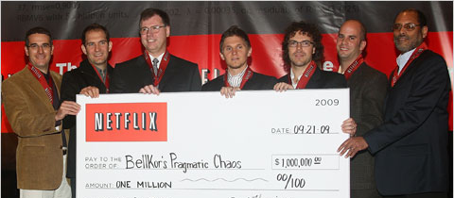
TRANSFORMING MEMBER ENGAGEMENT
Your Association
Simplify and Personalize the Member Experience
Data to improve Member Value and Association Programming
Engagement Growth = Revenue/Member Growth
Digital Transformation in 90 Days
Example: 2,000 Members $2,000,000 Annual Revenue
80% Retention ->93%
$260,000 / Annual Increase

Slide 30
Contact
dan.stevens@workerbee.tv
Visit
www.association.tv
THANK YOU
QUESTIONS & DISCUSSION

